Slide 1
Distributed Systems and Cloud Computing

Slide 2
Definition of a Distributed System
A distributed system is a collection of mostly autonomous processors communicating over a communication network and having the following features:
  No common physical clock. The inherent asynchrony amongst the processors
  No shared memory. Requires message-passing for communication.
  Autonomy and heterogeneity. The processors are “loosely coupled” in that they have different speeds and each can be running a different operating system.

Slide 3
Why Distributed Systems
Why?
  to connect physically separate entities
  to tolerate faults via replication
  to scale up throughput via parallel CPUs/mem/disk/net
  to achieve security via isolation
But:
  complex: many concurrent parts
  must cope with partial failure
  tricky to realize performance potential

Slide 4
Scalability
Scalability of a system can be measured along at least three different dimensions.
  First, a system can be scalable with respect to its size, meaning that we can easily add more users and resources to the system.
  Second, a geographically scalable system is one in which the users and resources may lie far apart.
  Third, a system can be administratively scalable, meaning that it can still be easy to manage even if it spans many independent administrative organizations.
Unfortunately, a system that is scalable in one or more of these dimensions often exhibits some loss of performance as the system scales up.

Slide 5
Scaling Techniques (1):
Asynchronous Communication
Hiding communication latencies is important to achieve geographical scalability
  Try to avoid waiting for responses to remote ( and potentially distant) service requests as much as possible.
  For example, when a service has been requested at a remote machine, an alternative to waiting for a reply from the server is to do other useful work at the requesters side.
Asynchronous communication can often be used in batch-processing systems and parallel applications, in which more or less independent tasks can be scheduled for execution while another task is waiting for communication to complete.
  Alternatively, a new thread of control can be started to perform the request.
  Although it blocks waiting for the reply, other threads in the process can continue.

Slide 6
Scaling Techniques (2): Partitioning
Distribution involves taking a component, splitting it into smaller parts, and subsequently spreading those parts across the system. This is called partitioning or sharding.
An excellent example of distribution is the Internet Domain Name System ( DNS).
  The DNS name space is hierarchically organized into a tree of domains, which are divided into nonoverlapping zones

Slide 7
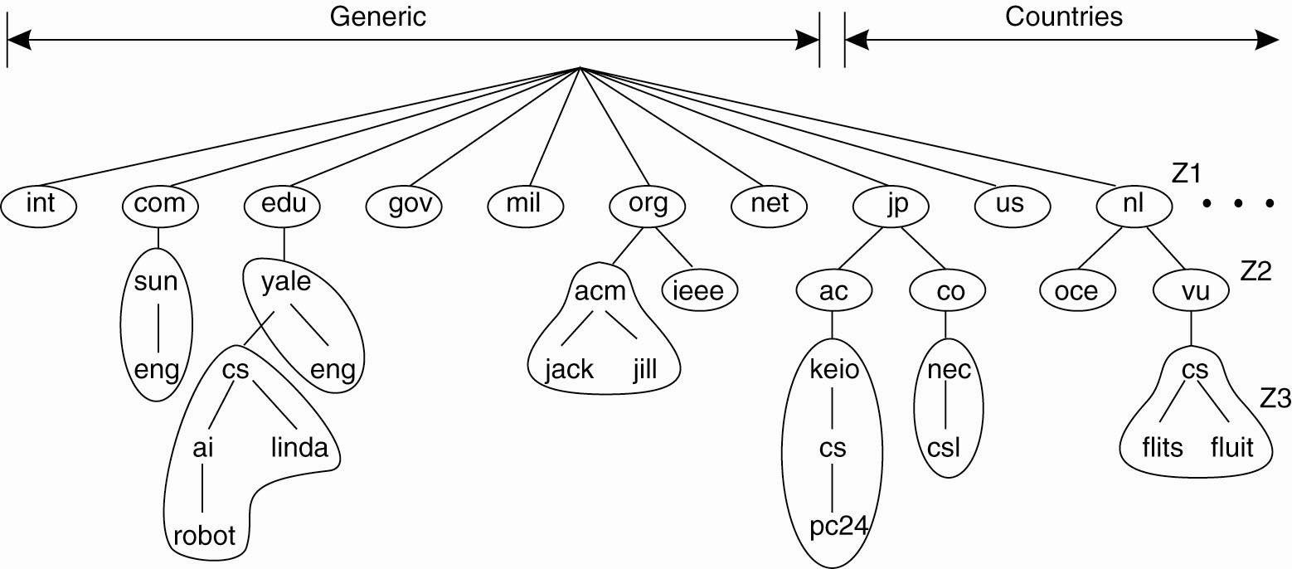
Scaling Techniques (2)
An example of dividing the DNS
name space into zones.

Slide 8
Scaling Techniques (3): Replication
Single leader and Followers
Multi-leader replication
Leaderless replication

Slide 9
Performance
The dream: scalable throughput.
  N servers -> N time total throughput via parallel CPU, disk, net.
  So handling more load only requires buying more computers ?
Scaling gets harder as N grows:
  Load im-balance, stragglers.
  Non-parallelizable code: initialization, interaction.
  Bottlenecks from shared resources, e.g. network.

Slide 10
Fault Tolerance
>1000s of servers, complex net -> always something broken
  We'd like to hide these failures from the application.
We often want:
  Availability -- app can keep using its data despite failures
  Durability -- app's data will come back to life when failures are repaired
Big idea: replicated servers.
  If one server crashes, client can proceed using the other(s).

Slide 11
Consistency
Achieving consistency is hard!
  "Replica" servers are hard to keep identical.
  Clients may crash midway through multi-step update.
  Servers crash at awkward moments, e.g. after executing but before replying.
  Network may make live servers look dead; risk of "split brain".
Consistency and performance are enemies.
  "Strong consistency" often leads to slow systems.
  High performance often imposes "weak consistency" on applications.
People have pursued many design points in this spectrum.

Slide 12
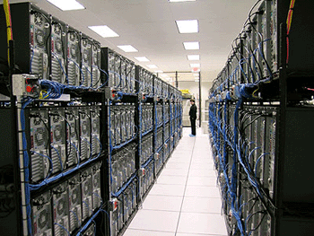
Cloud Computing
Elastic resources
  Expand and contract resources
  Pay-per-use
  Infrastructure on demand
Multi-tenancy
  Multiple independent users
  Security and resource isolation
  Amortize the cost of the (shared) infrastructure
Flexible service management

Slide 13
Data Centers
Rented and shared facilities
Can be over 300,000 square feet, 100,000 servers, 1 Billion dollars
Amazon AWS
Microsoft Azure
Google AppEngine
Cloud computing, Utility computing

Slide 14
Cloud Service Models
Software as a Service
  Provider licenses applications to users as a service
  E.g., customer relationship management, e-mail, …
  Avoid costs of installation, maintenance, patches…
Platform as a Service
  Provider offers platform for building applications
  E.g., Google’s App-Engine
  Avoid worrying about scalability of platform

Slide 15
Cloud Service Models
Infrastructure as a Service
  Provider offers raw computing, storage, and network
  E.g., Amazon’s Elastic Computing Cloud (EC2)
  Avoid buying servers and estimating resource needs

Slide 16
Four Defining Features
Massive scale.
On-demand access: Pay-as-you-go, no upfront commitment. Anyone can access it
Data-intensive nature: What was MBs has now become TBs, PBs and XBs.
  Daily logs, forensics, Web data, etc.
  Humans have data numbness: Wikipedia (large) compress is only about 10 GB!
New Cloud Programming Paradigms: MapReduce/Hadoop, NoSQL/Cassandra/MongoDB and many others.

Slide 17
Massive Scale
Facebook [GigaOm, 2012]
  30K in 2009 -> 60K in 2010 -> 180K in 2012
Microsoft [NYTimes, 2008] 150Kmachines
  Growth rate of 10K per month
  80K total running Bing
Yahoo! [2009]: 100K
  Split into clusters of 4000
AWS EC2 [Randy Bias, 2009] 40,000 machines
  8 cores/machine
eBay [2012]: 50K machines
HP [2012]: 380K in 180 DCs
Google: > 1M machines

Slide 18















Data Center Network Topology
Internet
CR
CR
. . .
AR
AR
AR
AR
S
S
S
S
S
S
. . .
A
A
…
A
A
A
…
A
Key
CR = Core Router
AR = Access Router
S = Ethernet Switch
A = Rack of app. servers
~ 1,000 servers/pod

Slide 19
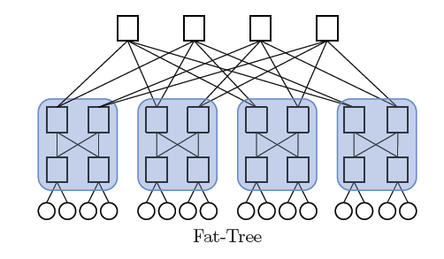
Data Center Network: Fat Tree Topology

Slide 20
On Demand Access
Pay-as-you-go, no upfront commitment. Renting a cab vs. renting a car, or buying one. Ex.:
  AWS Elastic Compute Cloud (EC2): a few cents to a few $ per CPU hour
  AWS Simple Storage Service (S3): a few cents to a few $ per GB-month

Slide 21
Data-intensive Computing
Computation-Intensive Computing
  Example areas: MPI-based, high-performance computing, grids
  Typically run on supercomputers (e.g., NCSA Blue Waters)
Data-Intensive
  Typically store data at datacenters
  Use compute nodes nearby
  Compute nodes run computation services
In data-intensive computing, the focus shifts from computation to the data: CPU utilization no longer the most important resource metric, instead I/O is (disk and/or network)

Slide 22
New Cloud Programming Paradigms
Easy to write and run highly parallel programs in new cloud programming paradigms:
  Amazon: Elastic MapReduce service (pay-as-you-go)
  Google (MapReduce)
    Indexing: a chain of 24 MapReduce jobs
    ~ 200K jobs processing 50PB/month (in 2006)
  Yahoo! (Hadoop + Pig)
    WebMap: a chain of 100 MapReduce jobs
    280 TB of data, 2500 nodes, 73 hours
  Facebook (Hadoop + Hive)
    ~300TB total, adding 2TB/day (in 2008)
NoSQL: MySQL is an industry standard, but Cassandra is 2400 times faster!

